Slide 1
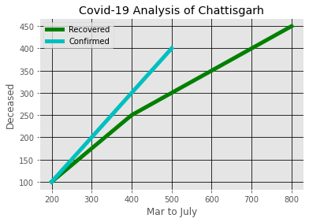
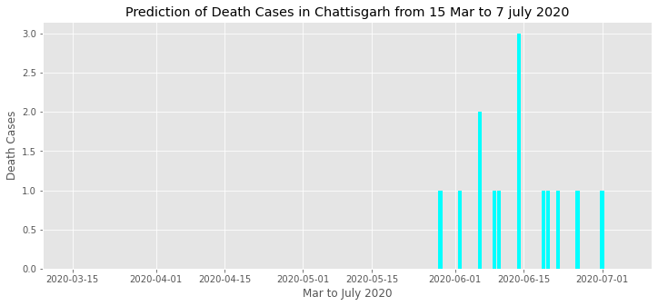
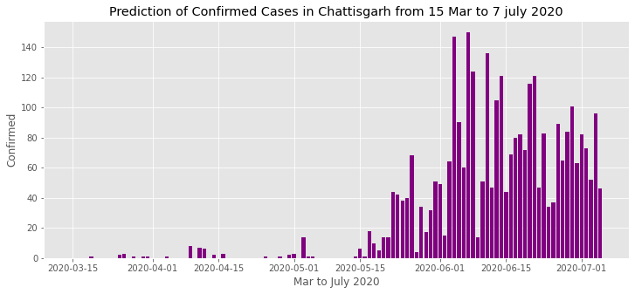
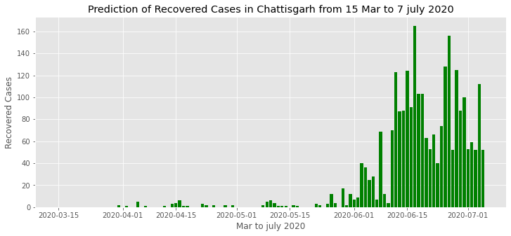
Brief Analysis of Covid-19 Cases in Chhattisgarh from Mar 2020 to 7 July 2020

Slide 2
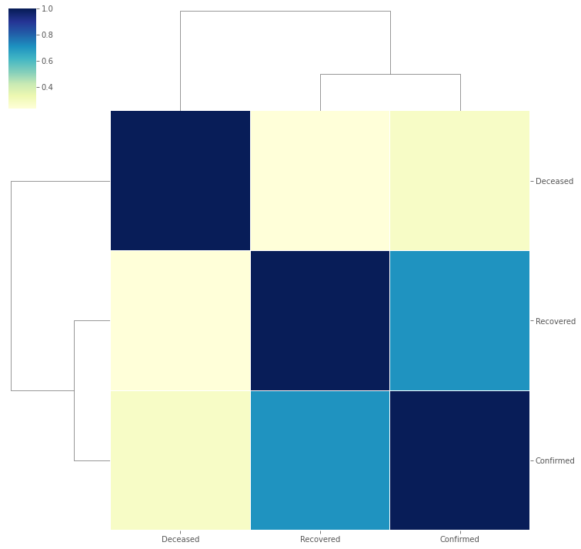
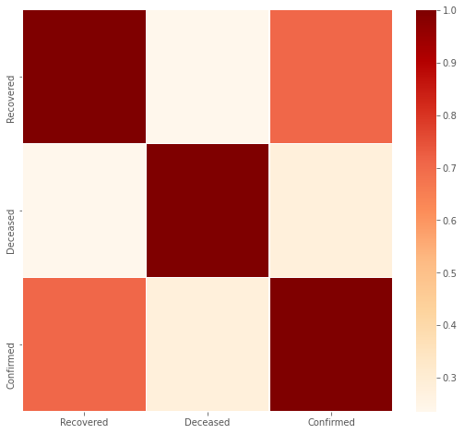
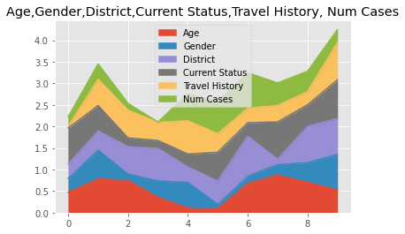
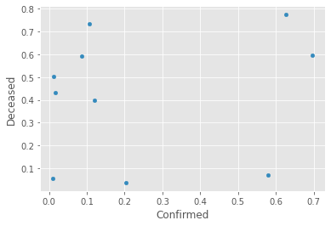
Brief Analysis of Covid-19 Cases in Chhattisgarh from Mar 2020 to 7 July 2020
Simple Correlation , Clustering Correlation b/w Confirmed, Deceased, Recovered

Slide 3
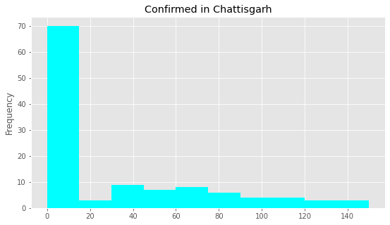
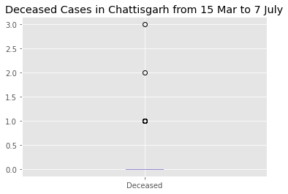
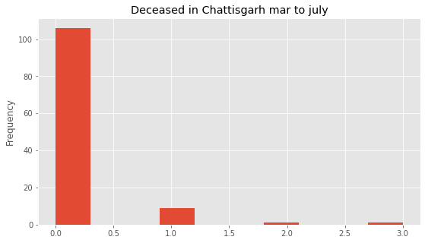
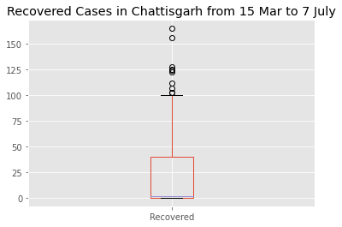
Brief Analysis of Covid-19 Cases in Chhattisgarh from Mar 2020 to 7 July 2020

Slide 4
Brief Analysis of Covid-19 Cases in Chhattisgarh from Mar 2020 to 7 July 2020
Correlation by Pearson between Confirmed, Recovered, Deceased
Correlation by Pearson | S no | Confirmed | Recovered | Deceased
Sno | 1.000000 | 0.770124 | 0.719866 | 0.285980
Confirmed | 0.770124 | 1.000000 | 0.708149 | 0.282082
Recovered | 0.719866 | 0.708149 | 1.000000 | 0.235328
Deceased | 0.285980 | 0.282082 | 0.235328 | 1.000000
Correlation by Kandall between Confirmed, Recovered, Deceased
Correlation by Kandall | Sno | Confirmed | Recovered | Deceased
Sno | 1.000000 | 0.640991 | 0.647008 | 0.264129
Confirmed | 0.640991 | 1.000000 | 0.578766 | 0.267361
Recovered | 0.647008 | 0.578766 | 1.000000 | 0.289411
Deceased | 0.264129 | 0.267361 | 0.289411 | 1.000000

Slide 5
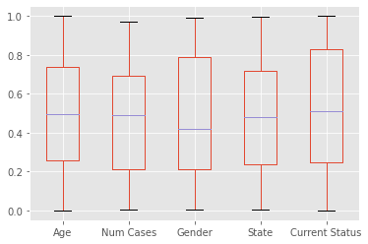
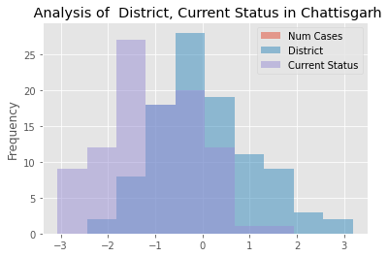
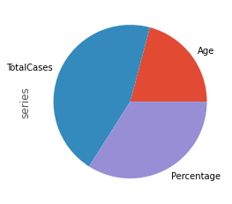
Brief Analysis of Covid-19 Cases in Chhattisgarh from Mar 2020 to 7 July 2020
Predict the Deceased Cases by Machine learning model
Test set predictions:
[0.02884343 0.55204618 0.0367051 0.14572427 0.28619012 0.02240166
0.05895369 0.3538549 0.02456283 0.02240166 0.02240166 0.02312205
0.24377063 0.02240166 0.07772555 0.02240166 0.02240166 0.02526235
0.02956382 0.02816478 0.03248712 0.18293407 0.02240166 0.02526235
0.02312205 0.03098373 0.02240166 0.02884343 0.41522402 0.23309001
0.02240166 0.0468949 0.05837939 0.44050026 0.37612436 0.26118519]
Accuracy by Logistic Regression is :91.66666666666666

